Slide 1
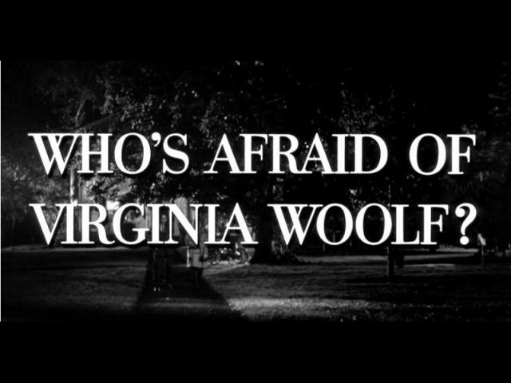

Slide 2
Introduction:
Who's Afraid of Virginia Woolf ? is a play by Edward Albee that opened on Broadway at the Billy Rose Theater on October 13, 1962.
Who's Afraid of Virginia Woolf ? won both the 1963 Tony Award for Best Play and the 1962-63 New York Drama Critics' Circle Award for Best Play.
It was also selected for the 1963 Pulitzer Prize for Drama by that award's drama jury.

Slide 3
Existentialism and Absurdism
The Theatre of the Absurd is commonly associated with Existentialism. The Existentialism was an influential philosophy in Paris during the rise of the Theatre of the Absurd. In order to call it Existentialist theatre is problematic for many reasons. It gained this association partly because it was named (by Esslin) after the concept of "Absurdism" advocated by Albert Camus, a philosopher commonly called Existentialist though he frequently resisted that label. Many of the Absurdists were contemporaries with Jean-Paul Sartre, the philosophical spokesman for Existentialism in Paris.
Some of the Absurdists were born in France such as Jean Genet, Jean Tardieu, Boris Vian . Many other Absurdists were born elsewhere but lived in France, writing often in French.

Slide 4
Who's Afraid of Virginia Woolf?
Religion and Wordplay
Who's Afraid of Virginia Woolf?, Edward Albee's first full-length play and his first to appear on Broadway, is considered by many to be his greatest dramatic achievement, as well as a central work in the contemporary American theatre. Virginia Woolf focuses on an angered academic couple who gradually draw a younger couple, freshly arrived from the Midwest, into their sinful games of marital love-hatred. The play is a dramatic blood sport struggled with words rather than weapons. “Verbal Fencing," wrote Ruby Cohn in Edward Albee, "in the most adroit dialogue ever heard on the American stage. The play premiered October 1962 at New York's Billy Rose Theatre.
For the play, Albee was additionally selected as the most promising playwright of the 1962-63 Broadway season by the New York Drama Critics' organization. When Albee did not receive the Pulitzer Prize for his widely-acclaimed play because one of the trustees objected to its sexual subject matter, drama advisors John Gassner and John Mason Brown publicly resigned from the jury in protest.

Slide 5
Failure of Religion in Albees Who's Afraid of Virginia Woolf
In Edward Albee’s controversial play, Who’s Afraid of Virginia Woolf ?, religion plays a major, yet often overlooked theme. There are constant references to God and Jesus throughout the play; in the third act, “The Exorcism,” George recites the Requiem for the Dead, the Catholic funeral mass. Throughout the play, these religious references and the character of Honey come to symbolize the failure of religion. Albee added these references to point out the fact that although religion is and has been ubiquitous, it still gives no answers. Most of the references to God and Jesus are swear words; “God damn,” and “Jesus Christ!” and the like. Even though these interjections are not the typical ‘reference ’ to God or Jesus, they bring a sense of knowing into the play’s set.

Slide 6
The Characters and Religion
The characters know about God and believe in Him. Martha claims to be an unbeliever, but that is suspicious because she especially uses ‘God damn’ to get her point across, and she gets very upset while George is reciting the Requiem. She knows that God is there, but won’t admit it. George recites the Requiem when his and Martha’s son ‘dies.’ The requiem was designed to comfort those people whose loved ones had passed on, so that they could let go. However, while George is reciting the requiem, Martha is in hysterics! She can’t let go of her ‘son’ and she is not comforted until George stops reading the mass. The character of Honey is somewhat of a paradox. She is the goody-goody preacher’s daughter on the surface, with dark secrets held underneath. She grew up surrounded by religion, and it did practically nothing to shape her morals. She appears to be the sweet, passive, pious woman that many preachers’ daughters grow up to be, but we see more of her as the play goes on. When Nick and George are talking outside for the first time, Nick reveals that he only married Honey because he thought she was pregnant. Honey knew she wasn’t pregnant, she only wanted to trap Nick into matrimony. Not a very Christian thing to do.

Slide 7
Also, she has been taking birth control and hiding it from Nick. There are three things wrong with that. First, birth control itself is against Christian belief. Second, withholding important information from someone who should know that information is considered lying within the Christian church. Third and finally, her selfishness goes against everything she should have learned growing up in the home of a preacher. Albee made and still makes a point in this play. ‘Although religion is supposed to be the answer, it gives none.’ That point is supported by every religious reference he added in. Every reference to God and Jesus being a swear word, the requiem causing grief instead of comfort, and finally the preacher’s daughter being everything but Christian. Albee definitely got his point across this time.

Slide 8

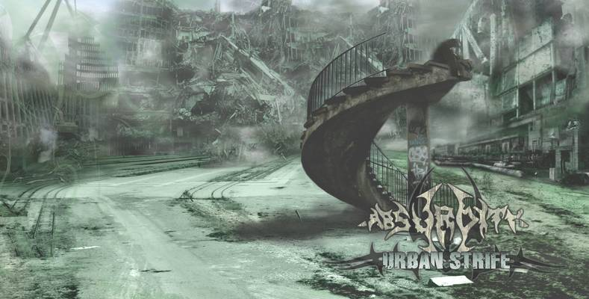

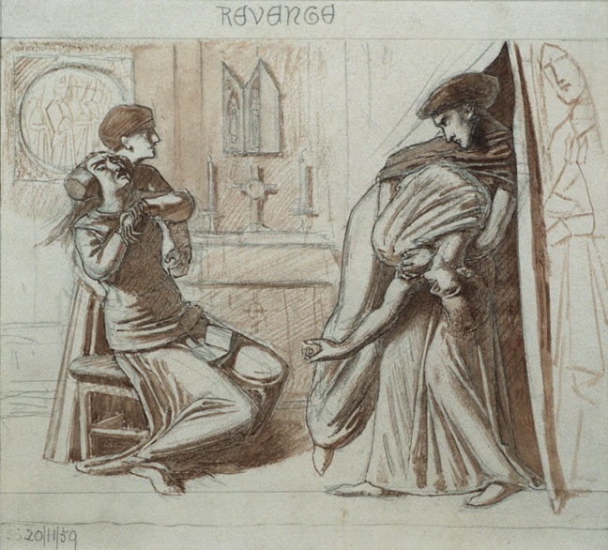
Themes

Slide 9
Absurdity
Literally meaning “out of harmony,” absurd was the existentialist Albert Camus’s designation for the situation of modern men and women whose lives lack meaning as they drift in an inhuman universe.
Virginia Woolf examine the question of what happens to human beings when they no longer have recourse to the illusions which had previously given their lives meaning. The theme of absurdity is a prevalent one in Albee’s plays, as is suggested by the frequent references to the theatre of the absurd in analyzing his writing. Albee describes the philosophical notion of absurdity as “having to do with man’s attempt to make sense for himself out of his senseless position in a world which makes no sense because the moral, religious, political and social structures man has erected to ‘illusion’ himself have collapsed.” Perhaps the most articulate and sustained expression of the absurdity of existence is found in George’s speech near the beginning of the second act, in which he concludes that despite all “the trouble to construct a civilization,” when the last trumpet sounds, “through all the sensible sound of men building,” the message to humanity will be, simply: “Up yours.”

Slide 10
Fear
As suggested by the title, the emotion of fear is a central thematic component of the play. To be afraid of “Virginia Woolf,” as Martha says she is at the play’s conclusion, is to admit a very human fear about the lack of inherent meaning in one’s existence. In order to feel fear, one has to have shed all of the illusions which had previously seemed to give life meaning. Thus, the play presents Martha’s fear as a life-affirming phenomenon. Better to acknowledge the fear and work through it, the play suggests, than to continue living a lie.

Slide 11
Revenge
The will for revenge appears to be a major force in George and Martha’s life. Each seems eternally to be seeking retribution for some past slight or insult. George’s “killing” of the invented son is planned as the ultimate act of revenge, for a series of humiliations public and private, and especially for Martha’s having broken a fundamental rule of their relationship, by mentioning the son to Honey. In the end, however, killing the son comes off more as a gesture of mercy, a necessary step to free both him and Martha from a destructive illusion.

Slide 12
Truth and Falsehood
Martha comments to George “Truth and illusion .. you don’t know the difference ” and his reply is, “No; but we must carry on as though we did ” The growth of these characters through the course of the play rests in the attempt to cease “carrying on ” and to attack falsehood on a number of levels, in the hopes of finding something true. Many deep secrets are revealed in the process, forcing the characters to confront the consequences. The primary “exorcism” in the play is the killing of Martha and George’s imaginary son, but other explosive confrontations with realities past and present abound in the play, for example: Nick’s confession of his material motives for marrying Honey, Honey’s revelation of her fear of bearing a child, and George’s trauma at having caused (if even accidentally) the deaths of his parents. At one point, George observes about his relationship with Martha: “accommodation, malleability, adjustment. those do seem to be in the order of things, don’t they?” Throughout the play, characters go through the more difficult process of peeling off layer after layer of pretense and artificiality. The play seems to suggest that even at the naked core of an individual there are destructive illusions, and the pain of losing them is staggering.

Slide 13
Common point between Existentialism and Absurdism
Which is both have no believe in religion and the difference?
which is an absurdist is not sure that he can control his fate or life where UNCERTAINTY prevails. While an existentialist is sure that he can control his fate and his life.
which one of them less religious?
In fact both have no believe in religion BUT existentialism tends to be less religious, since man to them is the master of his own fate.
First absurdist playwright is Aristophanes.
Absurdism is a reaction realism.
Beckett method is absurdist while Fugarde method is realistic.
1962 Absurdism is first time used as a term.
Which character dose not believe in god ?
Estragon

Slide 14

Amazing Girls
Hend Al-Harthy
Mona Al-Shehry
Hanaa Al-Turky
Mashael Al-jdany
Shatha Al-Amoudi

